Slide 1
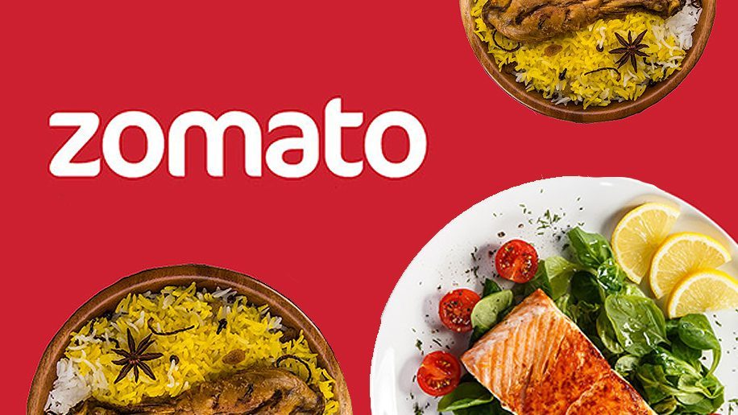
Zomato Analysis

Slide 2
Introduction of Zomato
Zomato is an Indian multinational restaurant aggregator and food delivery company.
It was founded by Deepinder Goyal and Pankaj Chaddah in 2008.
Zomato provides information, menus and user-reviews of restaurants as well as food delivery options from partner restaurants in more than 1,000 Indian cities and towns, as of 2022–23.
Zomato rivals Swiggy in food delivery and hyperlocal space.

Slide 3
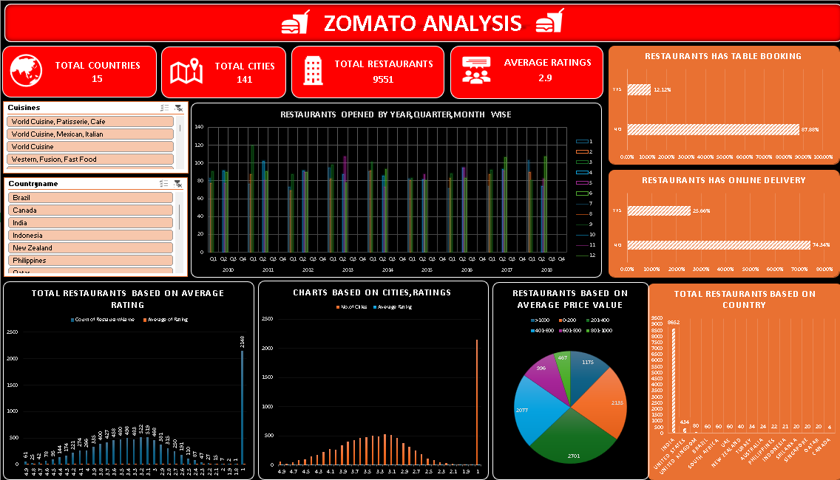

Slide 4
Observations:
Zomato is providing services across total 15 countries and 141 cities.
Total 9551 restaurants are partnered with Zomato to provide food delivery services.
Average Ratings for the total restaurants is 2.9.
Approximately 75% of restaurants provides online food delivery.
Approximately 88% of restaurants provides table booking.
India has the highest numbers of restaurants in all the countries that is 8662.
Most of the cuisines falls under 200-400 price range.

Slide 5
Conclusion/Insights:
According to the data, the highest restaurants covered are from India only, so Zomato should focus potential countries like USA ,UK ,Brazil to build their business.
According to the data, the average ratings for all the restaurants is 2.9 which is very less so Zomato should focus on quality of the food.
According to the data, the Zomato should focus on online delivery more to grow their business.
According to the data, the Zomato should focus on price range of the cuisines as the price range for the cuisines are very fluctuating so it should be pocket-friendly to grow the business.

Slide 6
Thank You

